Slide 1
Fundraising for Unicef : Idea Sharing
Prof. Sandra Cruz-Pol
Univ. of Puerto Rico - Mayagüez
UNICEF Team Advisor

Slide 2
Outline
Five (5) Fundraising Guidelines
8+ year experience/activities
Share your best experiences. We'll divide the group into teams to develop fundraising ideas tailored for your institution.

Slide 3
Fundraising Guidelines 1. Brainstorm:
Decisions: take details into account, costs, sale, party
Goals: set your goal$
Resources: what can you count on? Leverage.

Slide 4
Fundraising Guidelines 2. Plan:
Early in advance, specially for large events
Date: choose carefully, no conflicts w/other events
Venue: cost, location, size
Co-Hosting: leverage!
Budget Planning: ask for donations
Delegate responsibility

Slide 5
Fundraising Guidelines 3. Details:
Entertainment: look ahead of time for a good one
Decorations: don’t underestimate their power
Information: use event to create awareness
Publicity: very important! Use all possible means

Slide 6
Fundraising Guidelines 4. Running the Event:
Back up plan: to keep things running smooth
Volunteers: give precise directions of what u expect from them.
Timing: make sure event is punctual
Security: plan who will secure money and transport it from venue
Change: need petit-cash if selling goods

Slide 7
Fundraising Guidelines 5. Follow-up:
Donation: online or mail
Thanks: remember to thank everyone!
Unicef newsletter: write short article with photos for your local newspaper or campus web.
Report: After conducting your fundraiser, follow up by filling out a Fundraiser/Event Feedback Form. You should also share your thoughts on the event with the Campus Initiative group.
Reflect. Did the event meet your expectations? Did you reach the number of people you wanted to reach? Did you raise as much money as you had hoped you would? Think about what you have accomplished and congratulate yourself and your group for your hard work.

Slide 8
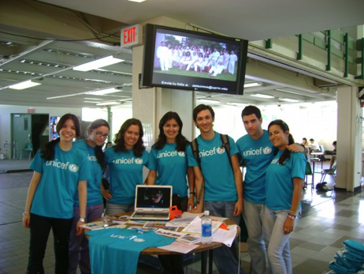
Our Past Fundraising Activities
MUSIC:
(350.org) rock concert, 2 talent shows, karaoke
Candle light (during EarthHour)
bake sales, flee market
All-Campus Lobbies infosessions
Trick or treating around campus
Web page (with factoids, videos, info)
Integration into curriculum (email)
Unicef online fundraising w/goal$, email, Facebook
Outreach: helped coordinate efforts at a private school where they collected $8k

Slide 9
High school collected $8k
How?
Pizza Party challenge
Videos –captive audience
Casual Day
IAO club
$8,000 !!

Slide 10
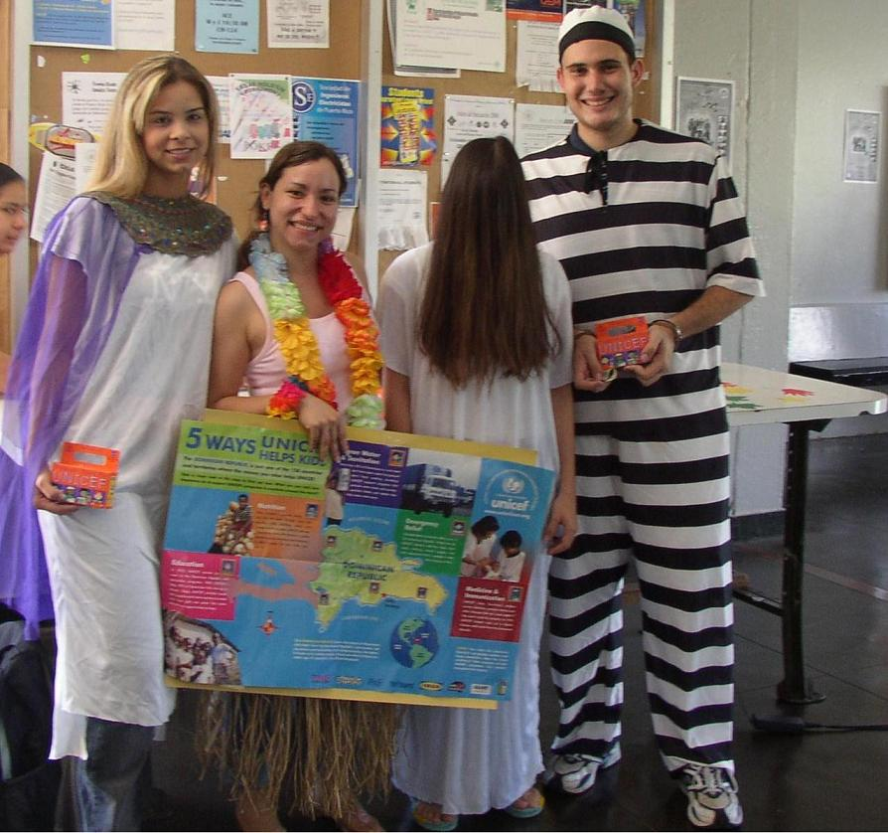

Slide 11
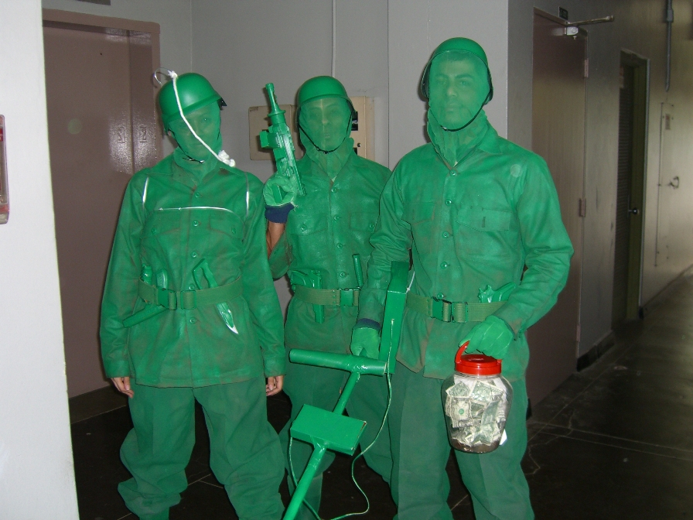

Slide 12
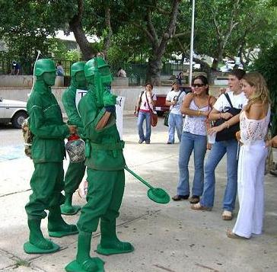

Slide 13
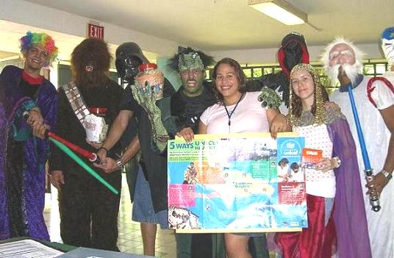

Slide 14
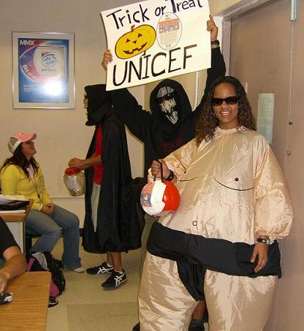
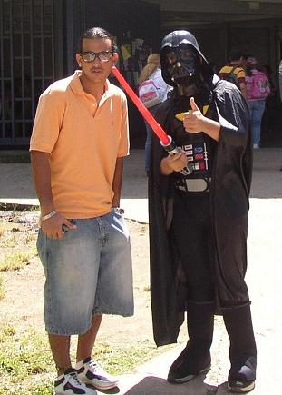

Slide 15
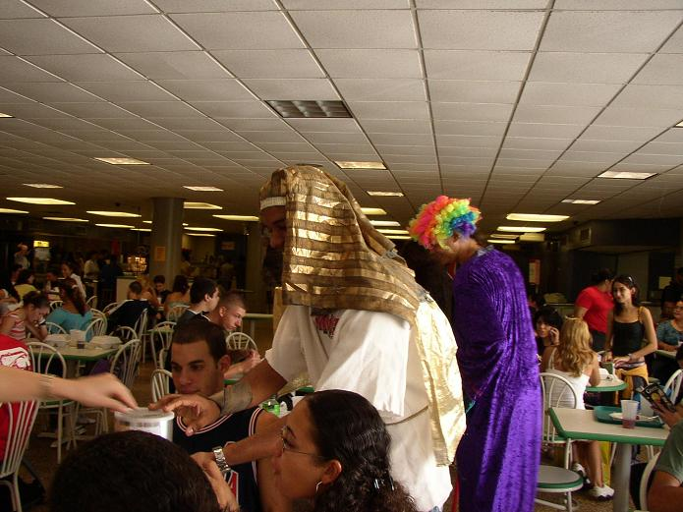

Slide 16
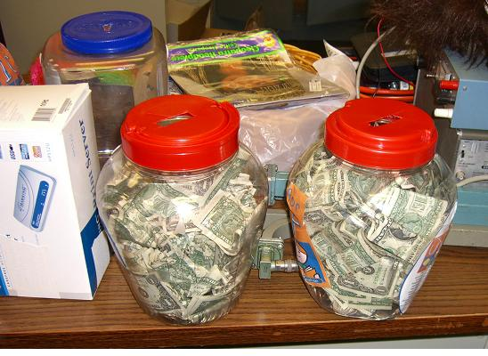

Slide 17
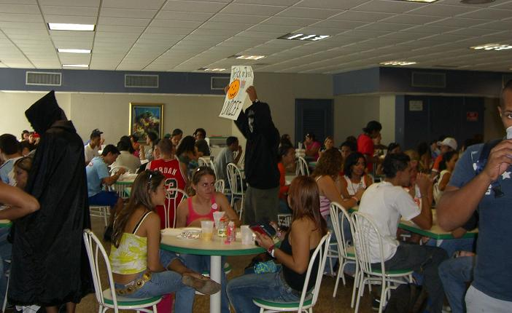

Slide 18
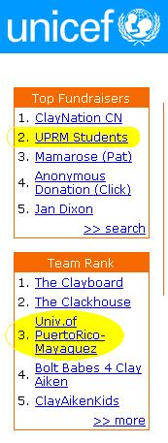

Slide 19
Talent 4 Life (2005-2006)
TV ad (free)
Low cost sound and lights
Known Host
Student design logo for T Shirts
Students design video ad
Many volunteers
Town venue: Cultural Center
Judges were volunteers too
But…

Slide 20
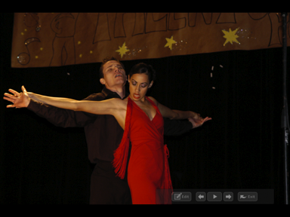
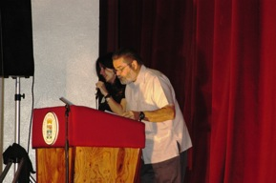
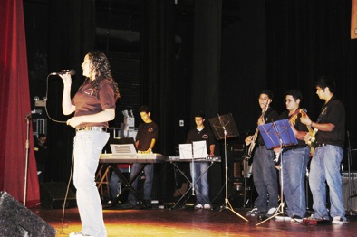
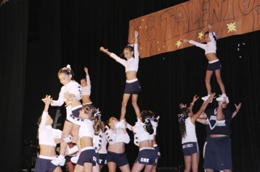
Talent for Life 2006

Slide 21
Talent for Life 2006

Slide 22
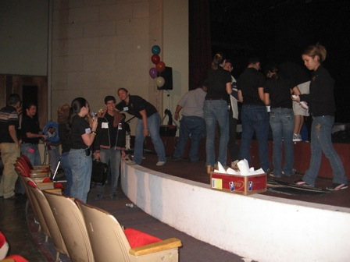
Talent for Life 2006

Slide 23
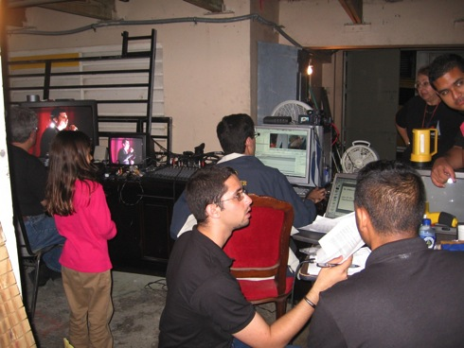
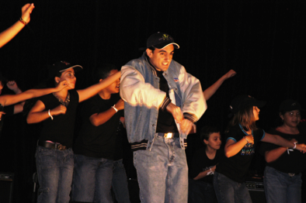
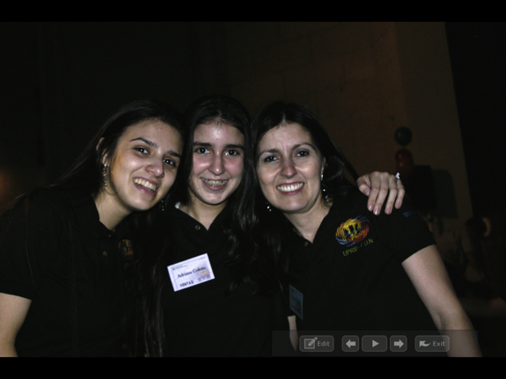
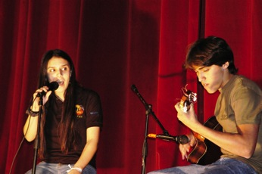
Talent for Life 2006

Slide 24
2009

Slide 25
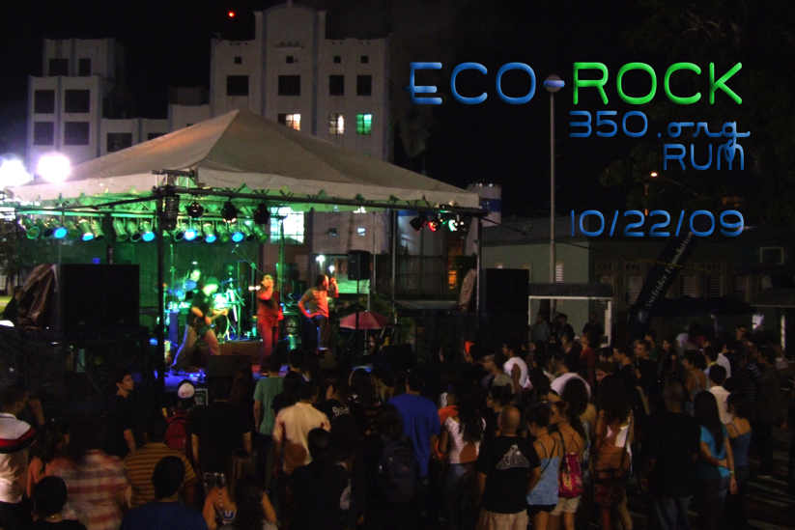
2009

Slide 26
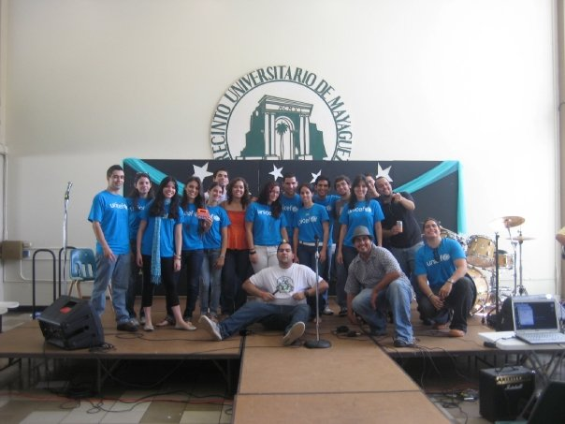
Unicef Talent 4 Life 2010

Slide 27
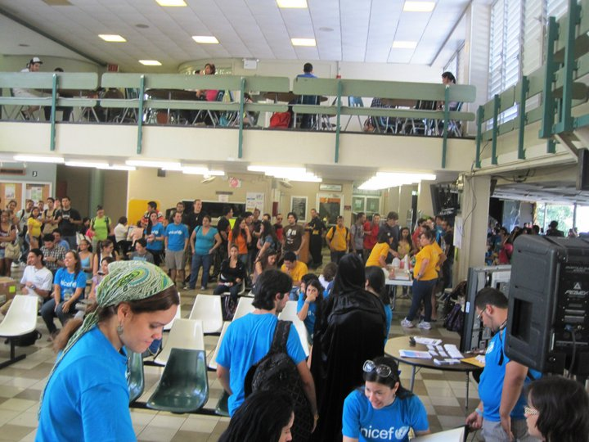
2010 Unicef Karaoke

Slide 28
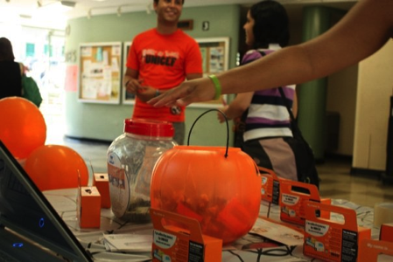
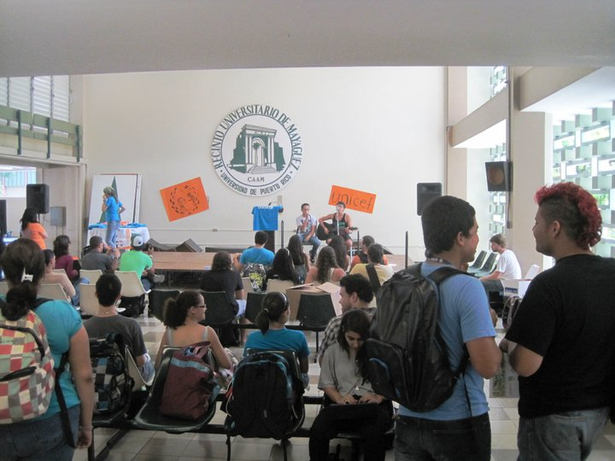
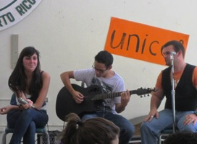
2010 Unicef Accoustics

Slide 29
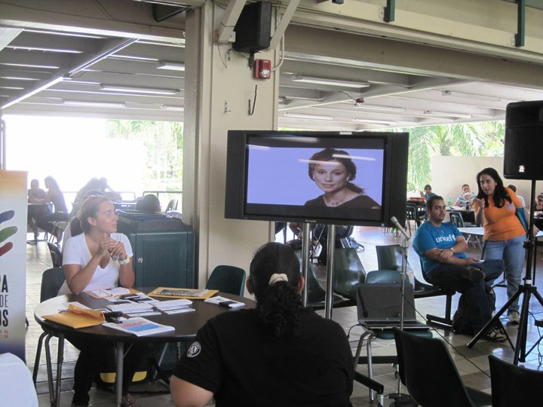
Std Center Info Table

Slide 30
UPR-Mayagüez donations

Slide 31
UNICEF Factoids…
Chicken pot kills 530,000 children every year and can be prevented with a vaccine that costs less than 50 cents per dosis.
The water used to flush one toilet …is 3 times more than the amount many people gets in a day.
1.1 billion poeple live with less than $1 a day
Africa has suffered drought for 2 decades!, due to climate change, eventhough it produces only 3% of GHG that cause it.

Slide 32
What is UNICEF?
UNICEF, the United Nations Children's Fund, was founded in 1946 to meet the emergency needs of children in war-torn Europe, China and the Middle East.
UNICEF now works in more than 158 countries.
In 1965, UNICEF was awarded the Nobel Peace Prize for Peace, linking its lifesaving work for children with world peace.
The U.S. Fund for UNICEF is a non-profit organization

Slide 33
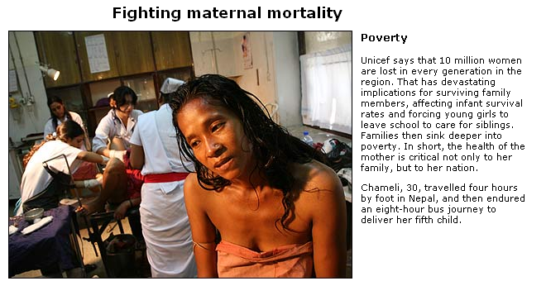

Slide 35
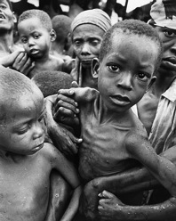
Every year 8 million people die…
…due to preventable causes …
like diarrhea, malaria, polio…
That’s 22,000 people every day!
(this is ~ 2x the amount of sutdents in UPRM! )

Slide 36
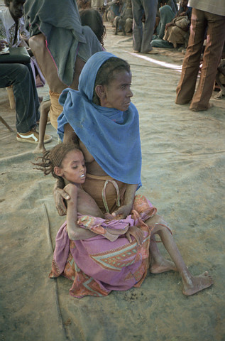
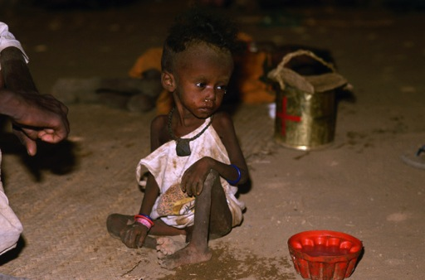
Every year 8 million people die…
…due to preventable causes …
like diarrhea, malaria, polio…
That’s 22,000 people every day!
(this is ~ 2x the amount of sutdents in UPRM! )

Slide 37
A little bit goes a long way… …Health:
One packet of Oral Rehydration Salts to treat diarrhea, a leading cause of death among children: $0.05 per packet
One emergency health kit containing essential medical supplies and drugs to cover the basic health needs of 10,000 people for three months:
$0.60 per person/ $6,000
Immunize one child against measles, a disease that spreads rapidly among displaced populations: $1.00 per child
Vaccinate one child against polio for life, protecting them against the disease and preventing its spread to nearby countries: $1.00 per child

Slide 38
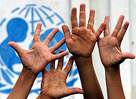
A little bit goes a long way… … in Nutrition:
One carton of high-protein biscuits to feed for severely malnourished children: $10.00 per carton
Aluminum cooking set intended for family use in emergencies, includes pots, bowls, cups, frying pan, and coffee pot: $13.75 for a 14 piece set

Slide 39
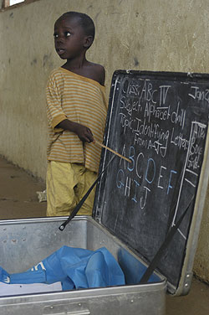
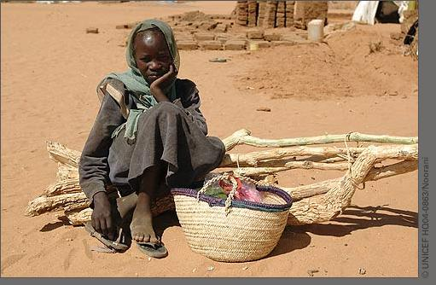
A little bit goes a long way… … in Education:
School-in-a-box kit to help resume education for children. Each kit contains enough educational materials for a teacher and up to 80 children and includes counting cubes, posters, a wooden teaching clock, and chalk: $300 per kit

Slide 40
Trick-or-Treat for
For over 50 years, ‘Trick-or-Treat for UNICEF” has raised funds and awareness on behalf of UNICEF through its motto,
Kids Helping Kids.
“Trick-or-Treat for UNICEF”
volunteers participate through local schools, civic, and faith-based organizations to inform the public about the problems
facing many of the world’s children.

Slide 41
All-Campus Lobbies info sessions
Our Past Fundraising Activities

Slide 42
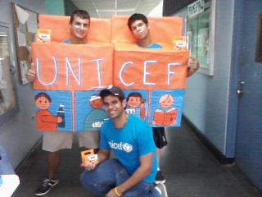
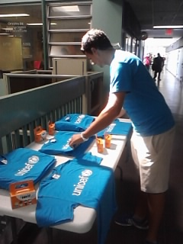
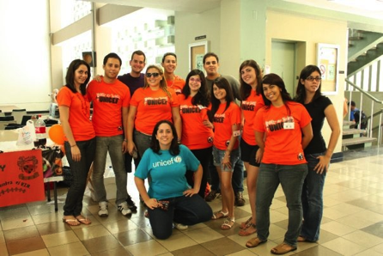
UPRM in Action!!

Slide 43
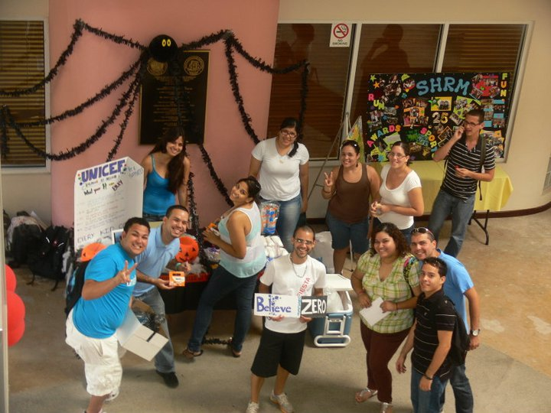

Slide 44
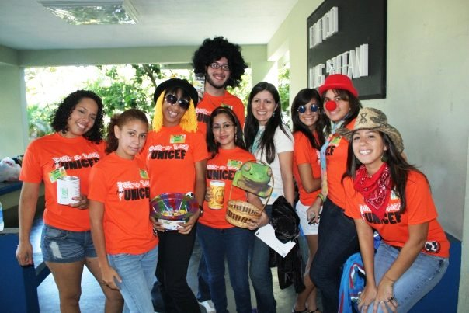
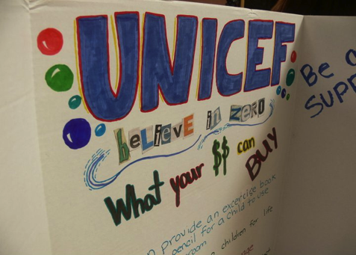
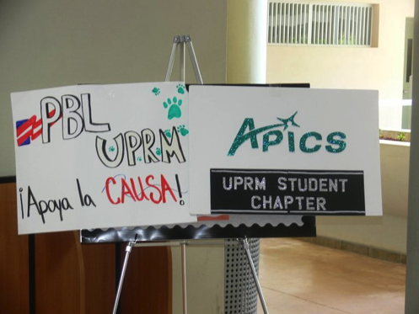

Slide 46
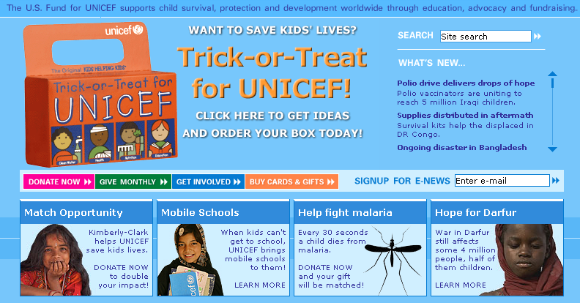
Unicef UPRM Team

Slide 47
Since 2003, UPRM has been among Top 5 of all teams in the U.S.!
This year our goal is $3000
Donate online! For UPRM Team
www.unicefusa.org/totonline/rum
Or at
http://ece.uprm.edu/~pol/UNICEF

Slide 48
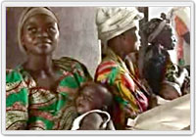
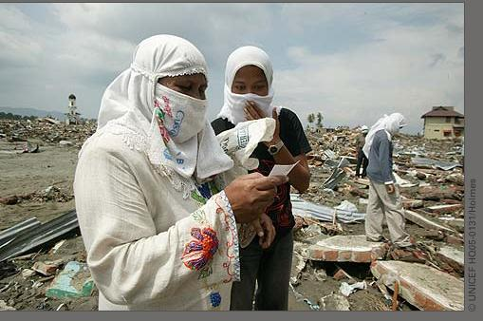
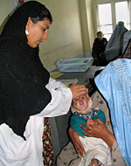
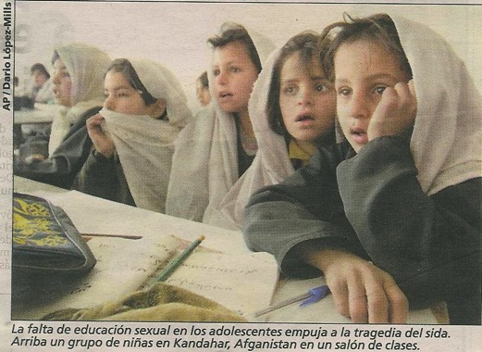
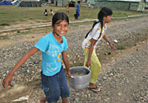

Slide 49
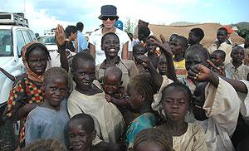
Since 2003, UPRM has been among Top 5 of all teams in the U.S.!

Slide 50
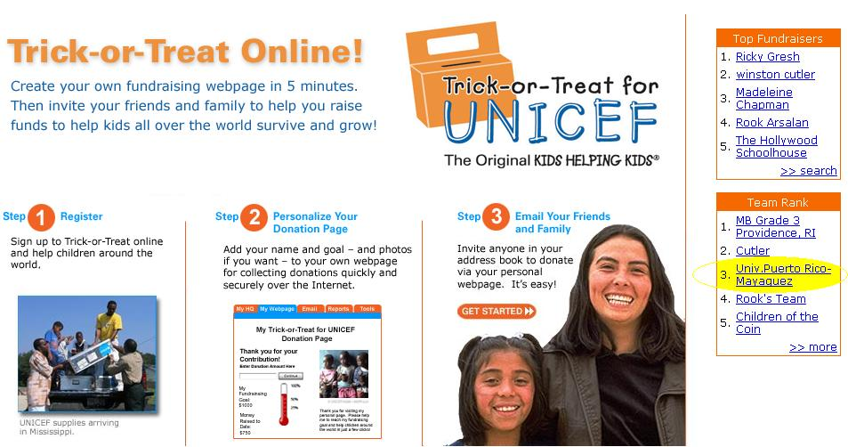
Our chapter at the University of Puerto Rico @ Mayagüez!
This particular year our goal was $3000!
We reached $3,469!

Slide 51
What worked…
Using big plastic containers in addition to orange boxes, so people see the bills
Showing short video clips
Emailing 14,000 campus population with links to our own website with videos, Factoids and link to Unicef official web with amount $ collected.
Lobby infosessions, delegate to studs assocs.
Campus Trick or Treating (showing our faces).
Post-email thanking and showing our accomplishments. Web with total donations.

Slide 52
General Fundraising Guidelines
Share information on where donations are going and how donations support UNICEF programs. If you can’t respond to a particular question from the public, please contact us so that we can give you the correct answer. *In our case 100%+ goes to Unicef
Expenses. Track your expenses and revenue at all stages of your fundraiser.
Keep us updated! Throughout the entire process of planning and carrying out the fundraiser, keep in contact with us at the U.S. Fund for UNICEF. Please update us on your progress and let us know if you have any questions, or need further support. Contact your local U.S. Fund staff member with updates.
Contact. Don’t be afraid to ask for advice or assistance. Seek out experienced fundraisers, campus advisors, the USF National Office, or use the egroup and ask your peers for advice. If you have any further questions, visit our website at www.unicefusa.org or volunteer@unicefusa.org.

Slide 53
“Be the change you want to see in the world”
Gandhi

Slide 54
Let’s hear about your ideas
Divide into groups and list:
Type of Activity
Resources:
Costs:
$ Goal:
Tasks for Volunteers
Means of Advertising:

